Slide 1
Generative Adversarial Networks
aka “GANs”

Slide 2
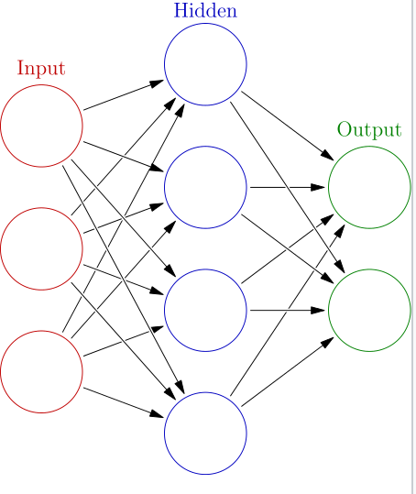
Introduction
Artificial Neurons: these things are inspired from biological neural network constituent neurons.
Neural Network applications
Computer Visioning
Speech recognition
Machine translation
Social networking filtering
Medical diagnosis
And many more…
These tasks are difficult but these can be automated

Slide 3
GAN… but what is this??
“(GANs), and the variations that are now being proposed is the most interesting idea in the last 10 years in ML, in my opinion.”- Yann LeCunn, Director of AI Research at Facebook
Cheater Network
Contest between forger and investigator

Slide 4
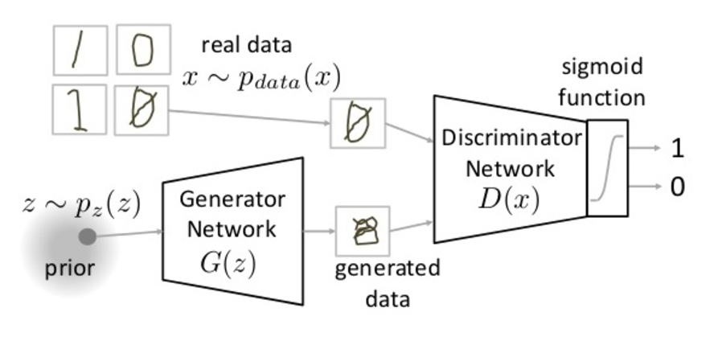
GANs Working
Pdata(x) -> the distribution of real data X -> sample from pdata(x) P(z) -> distribution of generator Z -> sample from p(z) G(z) -> Generator Network D(x) -> Discriminator Network

Slide 5
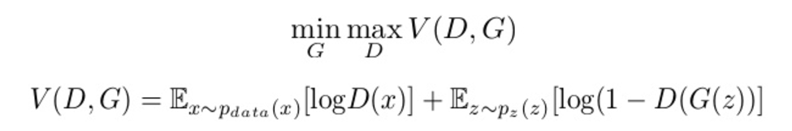
Lets do some Maths…
First function is Entropy of data from real distribution (pdata(x))
Second function is Entropy is data from Generated Network where input is random input (p(z))
Discriminator tries to maximize the function V

Slide 6
Training GAN
Step 1: Problem definition
Step 2: GAN Architecture definition
Step 3: Training of Discriminator on real data
Step 4: Generate fake inputs for generator and train discriminator for fake data
Step 5: Train generator with output of discriminator
Step 6: Repeat steps for few epochs
Step 7: Check the fake data and manually and compare if the data is correct.

